Slide 1

Munawar Iqbal Faruqui (born 28 January 1992) is an Indian stand-up comedian, writer and rapper who is known for his jokes and songs.
Faruqui was born in Junagadh, Gujarat, on 28 January 1992 to a muslim family. Due to the impact of the 2002 Gujarat riots, in 2007 he, along with his family (his father and his three sisters), shifted to Dongri, Mumbai, to make a fresh start.
At the age of 17, he was compelled to work for his family when his father fell sick. He worked at a utensil store while attending school.
In his early twenties, he worked as a graphic designer. In 2017, when various OTT platforms were introducing in India he became aware of comedy and he began working as a comedian.
MUNAWAR FARUQUI
punished for a joke he didn’t crack

Slide 2





The story of Munawar faraqui was covered by opindia on January 3’2021 by Ajeet Bharati. This was when Munawar was arrested by Indore police on being informed by some people that he is “going to crack some jokes on Hindu god/goddess”
He continued to stay in jail for a long period of one month for a joke he didn’t crack; even till this date no one has any evidence that Munawar was going to crack any joke of that sort.
It was on February 5’2021 that the top court of the nation finally granted him bail
OPINDIA
The news coverage by Ajeet Bharati included some harsh and disturbing use of language:
He used the term “HARAMKHOR” and “DOGLA” to counterpart the “liberals” supporting Munawar
Quoted that islam was no religion and by default all the muslims are radical
opindia
A hate mongering angle instigated by the right wing can be clearly seen in the story coverage by opindia. The information provided was far away from factuality and tend to impose their views on the public.
Opindia.com
Opindia.com
Opindia_in

Slide 3
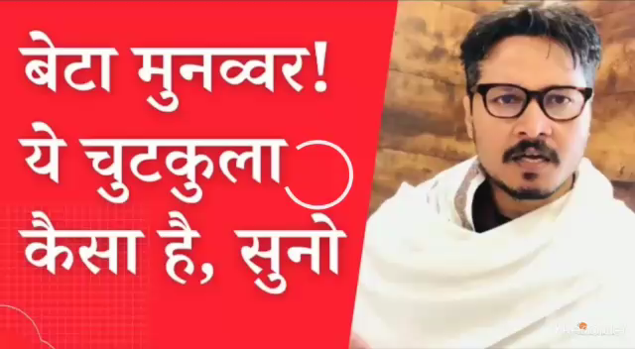
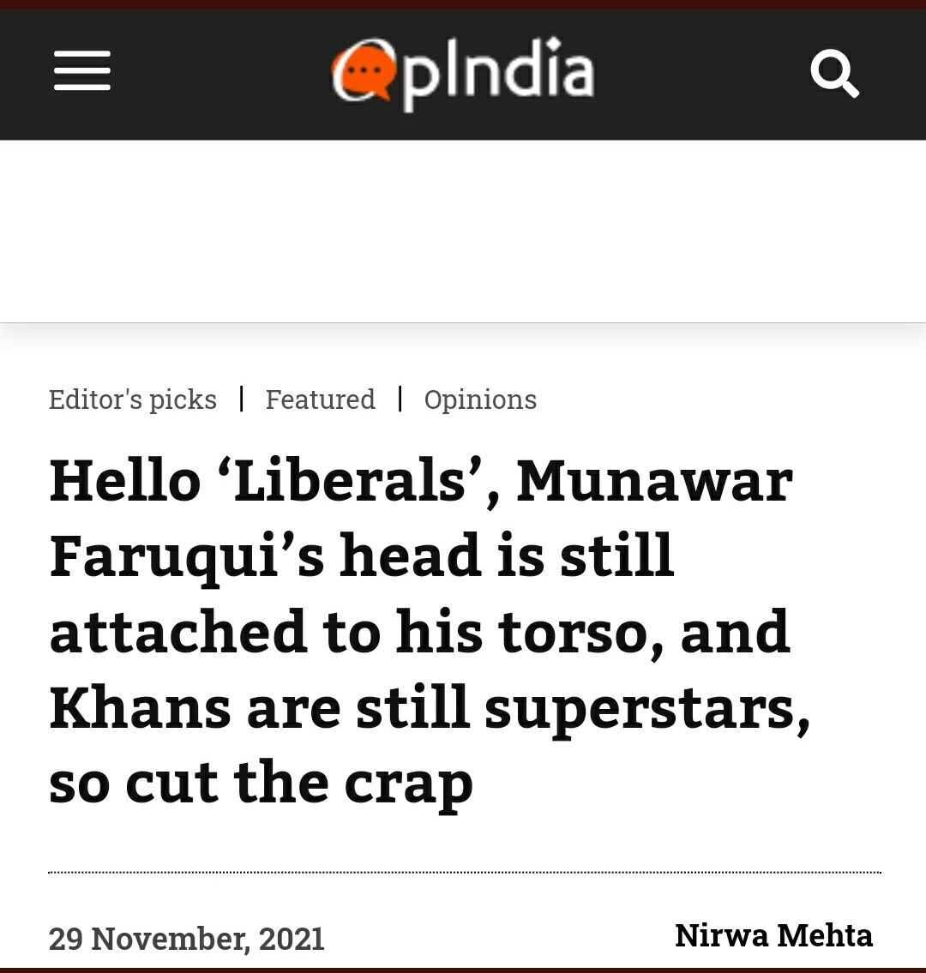
https://youtu.be/hDIAnRO7HYQ

Slide 4

Story of the whole incident was covered seven times by mojo story. The most recent one came after Munawar announced that he will not be continuing comedy.
The coverage was in conversation between Barkha Dutt and the former supreme court judge of the country- Justice Deepak Gupta; who at the time of Munawar’s arrest highlighted about the shrinking freedom of speech in India.
The information appeared much more factual and asked questions to the audience and left them on making their own opinion.
Protecting and empathising with the minority of the nation along with protecting rule of law of the country appeared to be the angle of coverage.
Throughout the conversation respected use of language was maintained.
MOJO STORY
TheMojo
Mojo story
themojostory
This Photo by Unknown Author is licensed under CC BY-SA-NC

Slide 5

https://youtu.be/hDIAnRO7HYQ
https://youtu.be/hDIAnRO7HYQ

